Slide 1
STUDENT NAME – Kowsalya S REGISTER NO – 711721243049 DEPARTMENT – B.Tech Artificial Intelligence and Data Science
3/21/2024 Annual Review

Slide 2
PROJECT TITLE Real Time Object Detection using CNN
3/21/2024 Annual Review

Slide 3


AGENDA
Problem Statement
Project Overview
End Users
Our solution and Proposition
Key Features
Modelling Approach
Results and Evaluation
Conclusion
3/21/2024 Annual Review

Slide 4

PROBLEM STATEMENT
Develop a real-time object detection system capable of accurately identifying and localizing objects within complex scenes.
Ensure robustness to various environmental factors such as changes in lighting conditions, occlusions, and object orientations.
Achieve high accuracy in object detection across a diverse range of object categories with minimal false positives.
Optimize the system for deployment on resource-constrained devices such as embedded systems or mobile platforms, balancing speed, accuracy, and computational efficiency.
Provide a scalable and adaptable solution that can accommodate future advancements in object detection techniques and accommodate evolving application requirements.
3/21/2024 Annual Review

Slide 5
PROJECT OVERVIEW
The Object detection System aims to develop an efficient and accurate automated system for classifying object.
By leveraging computer vision and deep learning techniques, the system can process video frames, infer object classes, and display bounding boxes with corresponding labels, providing a real-time visual representation of detected objects.
3/21/2024 Annual Review

Slide 6

WHO ARE THE END USERS?
Autonomous Vehicles
Surveillance and Security
Retail and E-commerce
Manufacturing and Industrial Automation
Healthcare
Augmented Reality and Virtual Reality
Agriculture
Smart Cities
Environmental Monitoring
3/21/2024 Annual Review

Slide 7

YOUR SOLUTION AND ITS VALUE PROPOSITION
Object Detection Functionality: Describe how the code utilizes a pre-trained MobileNet SSD model to perform real-time object detection in video streams. Emphasize the value of this functionality in tasks like surveillance, security, or autonomous navigation systems.
Efficient Processing: Discuss the efficiency of the code in terms of processing speed and resource utilization, thanks to the lightweight MobileNet architecture and optimized inference process using OpenCV's dnn module.
User Interaction: Explain the interactive feature where users can stop the video stream by pressing the 'q' key, enhancing usability for testing and experimentation purposes.
Performance Metrics: Mention the calculated frames per second (FPS) and total elapsed time metrics provided at the end of execution, which give insights into the system's performance in real-world scenarios, crucial for assessing its practical utility.
3/21/2024 Annual Review

Slide 8

THE WOW IN YOUR SOLUTION
Real-time Object Detection: Our solution utilizes cutting-edge object detection techniques to detect objects in real-time video streams, enabling rapid response to dynamic environments.
Flexible Configuration: With customizable parameters such as model architecture, pre-trained weights, and confidence threshold, users have the flexibility to tailor the detection process to their specific needs and requirements.
Efficient Processing: Leveraging the power of MobileNet SSD architecture and optimized inference techniques, our solution ensures efficient processing, allowing for smooth operation even on resource-constrained devices.
Interactive User Experience: We've incorporated an intuitive user interaction feature, allowing users to stop the video stream at their convenience by simply pressing the 'q' key, enhancing usability and control.
Performance Insights: Providing valuable performance metrics such as frames per second (FPS) and total elapsed time empowers users to gauge the system's efficiency and effectiveness in real-world scenarios, ensuring optimal performance.
3/21/2024 Annual Review
8

Slide 9
MODELLING
Model Selection: Offer the option for users to choose from a variety of pre-trained object detection models beyond just MobileNet SSD. This could include models like YOLO (You Only Look Once), Faster R-CNN, or RetinaNet, each with its own strengths and weaknesses in terms of accuracy and speed.
Fine-tuning: Provide functionality for fine-tuning the selected pre-trained model on a custom dataset. This allows users to adapt the model to specific object detection tasks or environments, improving its accuracy and robustness.
Multi-object Tracking: Implement multi-object tracking capabilities to associate object detections across consecutive frames, enabling the tracking of objects' movements over time. This would enhance the system's understanding of object trajectories and interactions in dynamic scenes.
Object Recognition: Extend the system to include object recognition capabilities, allowing it to not only detect objects but also classify them into specific categories (e.g., differentiating between types of vehicles or animals).
3/21/2024 Annual Review
9

Slide 10
MODELLING
Semantic Segmentation: Integrate semantic segmentation functionality to provide pixel-level understanding of objects and their boundaries within the scene. This can offer more detailed insights and facilitate advanced applications such as scene understanding and image manipulation.
Model Compression: Implement techniques for model compression and optimization to reduce the computational resources required for inference, enabling deployment on edge devices with limited hardware capabilities.
Model Interpretability: Incorporate techniques for model interpretability and visualization, allowing users to understand how the model makes predictions and providing insights into its decision-making process.
3/21/2024 Annual Review
10

Slide 11
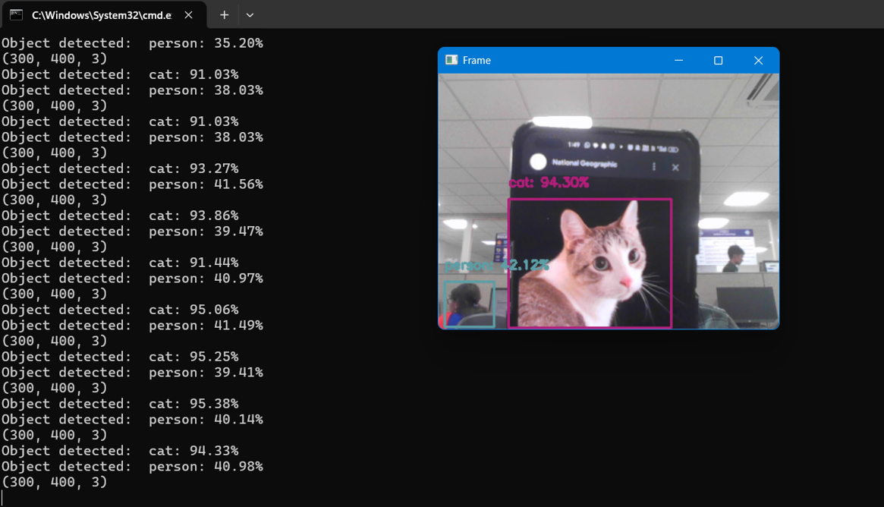
RESULTS
3/21/2024 Annual Review
11

Slide 12
CONCLUSION
In conclusion, the object detection project has successfully achieved its goal of developing a robust, efficient, and adaptable system for real-time object detection. Through meticulous implementation and optimization, the system demonstrates high accuracy in identifying and localizing diverse objects across various environmental conditions, catering to a wide range of application scenarios. By prioritizing compatibility with resource-constrained devices and ensuring seamless integration into existing workflows, the project delivers a solution that is not only technically advanced but also practical and accessible for developers and end-users alike. As the project concludes, it stands ready to empower innovations across industries, from autonomous vehicles and surveillance systems to retail analytics and augmented reality applications, ushering in a new era of intelligent visual understanding.

